Slide 1
Modelling in Epidemiology Group Presentation
Written by Jamie Merchant, Andronikos Chalatzioukas, and James Latto

Slide 2
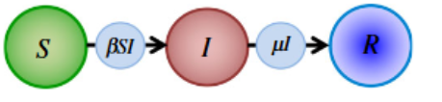
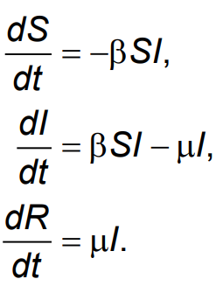
Introduction to the Compartmental Deterministic SIR Model
Three compartments: susceptible, infected and recovered
track rate individuals move around compartments
β and μ control rates of movement between compartments
Assumptions:
individuals are infectious immediately after being infected
everyone mixes with everyone else
individuals can only be infected once
differential equations solved simultaneously

Slide 3
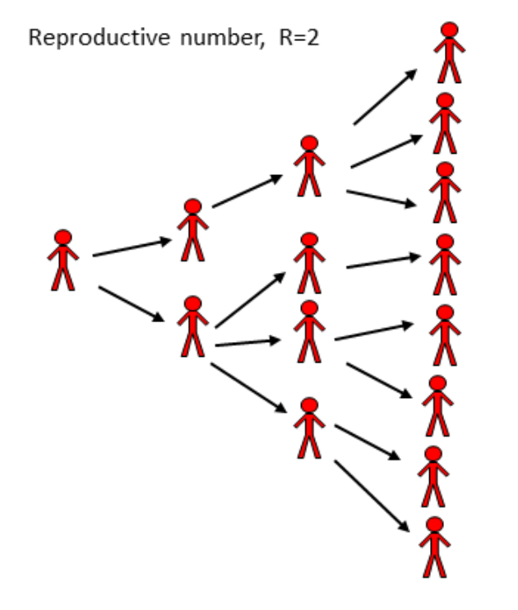
Basic Reproduction Number
R0 = Infection rate x Duration of infection
R0 = β N x 1/μ
R0 gives the average number of people and infectious person will infect (in an entirely susceptible population)
If R0 > 1 the number of infections will grow (initially)
If R0 < 1 the number of infections will decrease (initially)

Slide 4
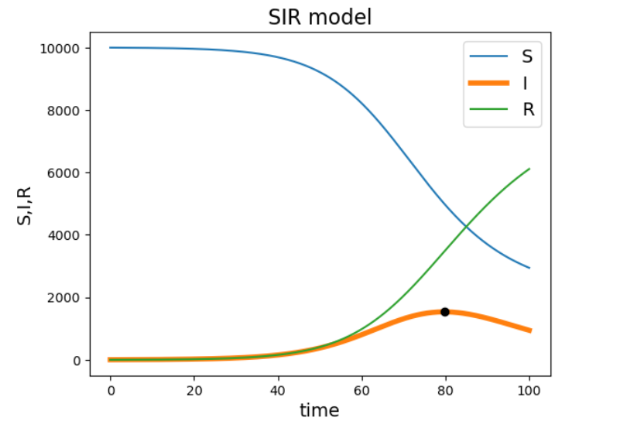
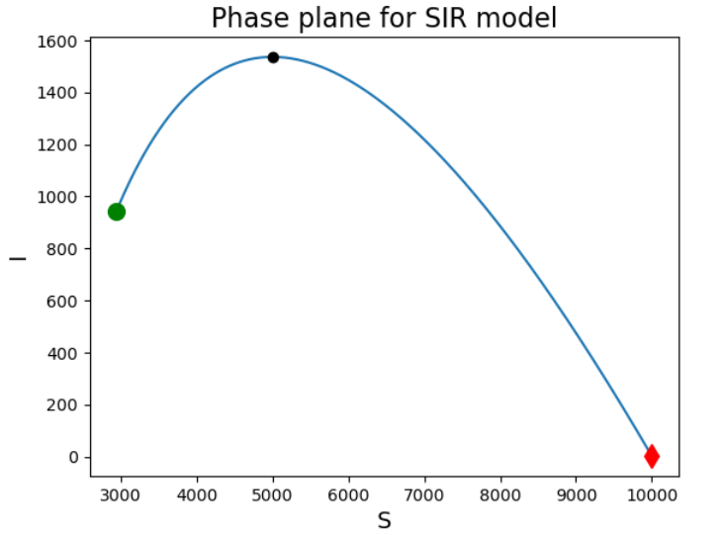
Deterministic SIR Model Graphs
parameters: β = 2 x 10^-5, μ = 0.1, N = 10 x 10^4, I(0) = 3

Slide 5
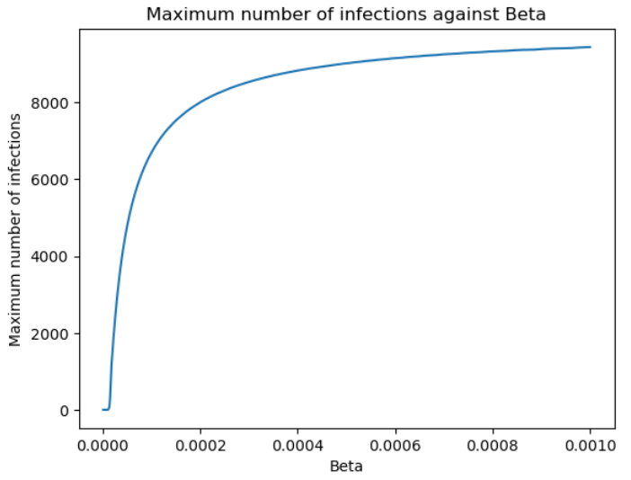
Effect of β on model
β values vary from 10^-6 to 10^-3
When β is near 0 no outbreak occurs
Initially a small increase in β gives a large increase in outbreak size
As maximum number of infections approaches total population size β has a decreasing effect on the outbreak size
parameters: μ = 0.1, N = 10 x 10^4, I(0) = 3

Slide 6
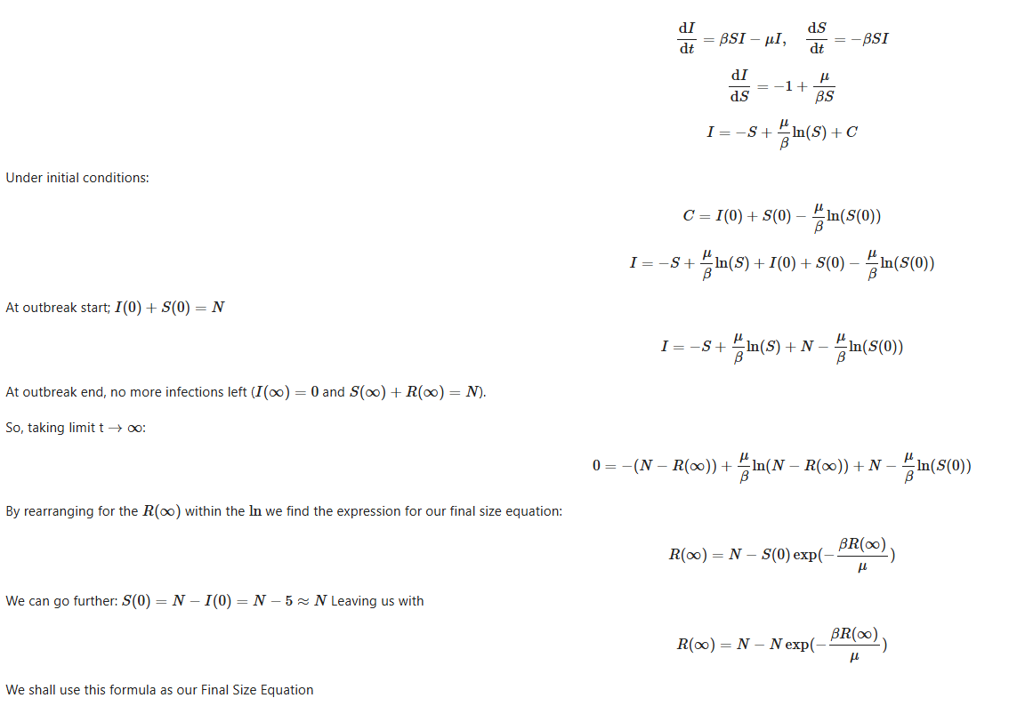
Derivation of the Final Size Equation Part 1
The final size equation allows us to analytically find the equation that describes the total number of people infected (then moved to R) over the disease’s lifetime.
Under initial conditions:
Using S(0) + I(0) = N:

Slide 7
Derivation of the Final Size Equation Part 2

Slide 8
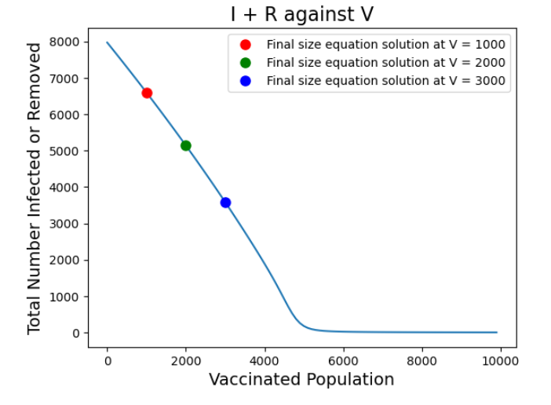

The effect of vaccination on total infected individuals
In our model we considered only vaccination at t = 0 where the V individuals vaccinated are removed from the S compartment. This means we can easily adapt our final size equation by replacing N with N - V.
This means we can investigate the effect of vaccination on future outbreaks of that disease by numerically solving and subsequently plotting the solutions of the final size equation against V as we have on the right.
Here we see that there is initially a sharp, almost linear decrease in the total number of infected with V which can be seen by the progressive reduction in infections for scenarios V = 1000, V = 2000, V = 3000.
We also find beyond a critical threshold of vaccination (about half the total population), the epidemic almost completely vanishes where herd immunity has been achieved.
This has policy implications that to reduce the impact of epidemics we should aim to maximise vaccination of known diseases to prevent future major outbreaks.

Slide 9
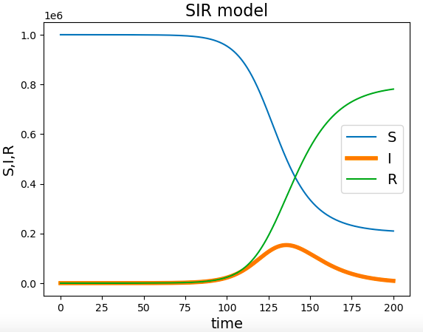
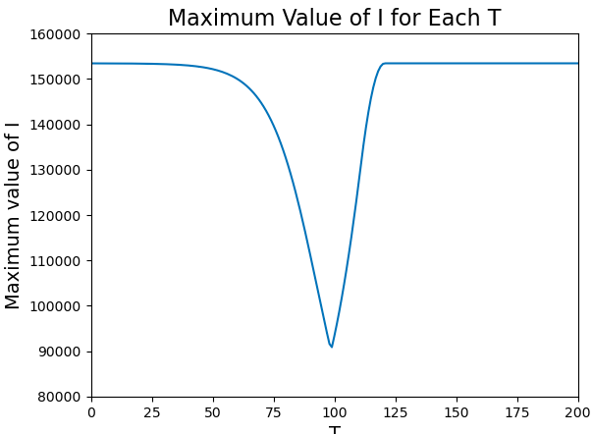
The effect of social distancing
Social distancing can be modelled by decreasing the value of β, the infection rate parameter, for the period of time when it is in effect.
In our model we initially considered implementing social distancing between 30 and 60 days after the first infection, to observe the effect it would have on the variables S, I, and R.
Next, we want to examine the effect of enforcing social distancing for any 30 day interval up to 200 days after the first infected. More specifically we want to identify the maximum number of infected for each 30 day interval, and further, which interval minimises that maximum value.
From the figure on the right, we can see this occurs when T (the start of the 30 day period) is 99.
This may be useful if social distancing can only be imposed for a short period (such as 30 days in this model) for socioeconomic reasons (e.g people being unable to work, entertainment, healthcare, transport).
Graph depicting S, I, and R as functions of time when social distancing is implemented between t = 30 and t =60
Graph depicting maximum I value for each 30 day interval

Slide 10
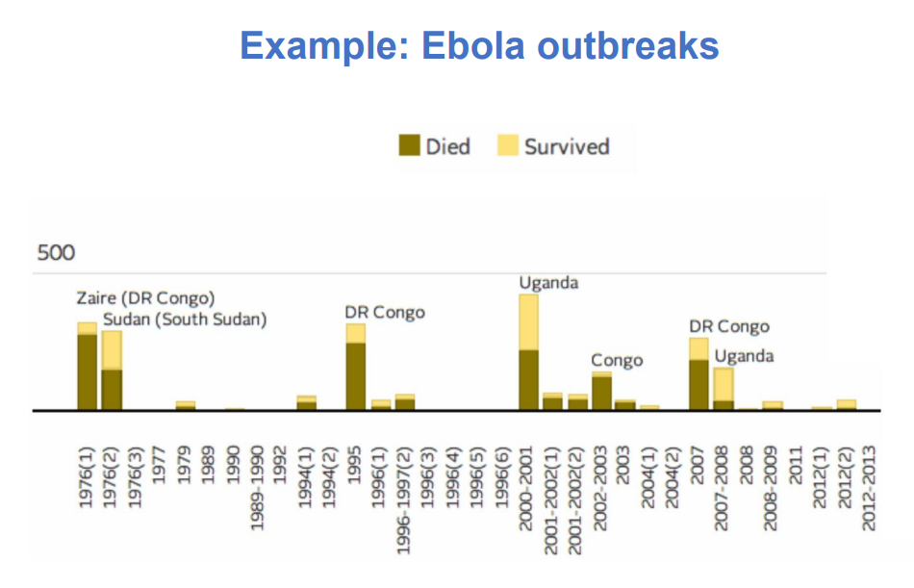
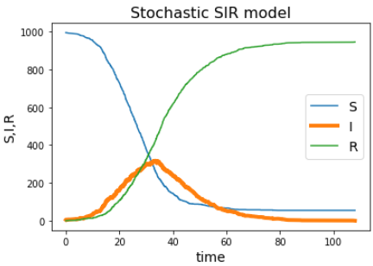
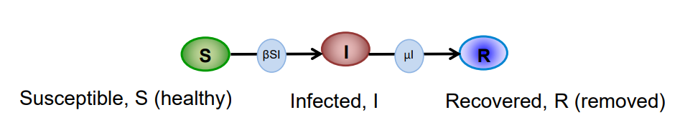
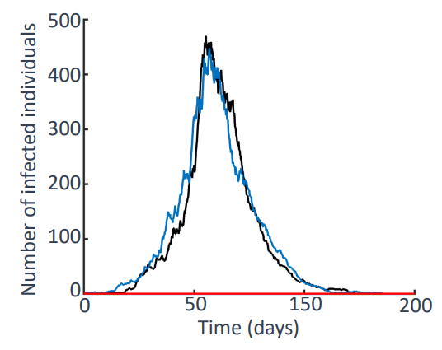





Introduction to the Stochastic SIR Model
Disease outbreaks are inherently random events as they rely on human interactions so you shouldn’t expect the same number of people to be infected each time under similar initial conditions as illustrated using data from the ebola outbreaks in DR Congo.
So to simulate a stochastic version of this SIR model we use the Gillespie direct method which assumes that events occur at exponentially distributed time intervals with rate parameter 𝛽𝑆𝐼 + 𝜇𝐼. This method works as follows: 1. Whilst I > 0, find two random numbers r1, r2 uniformly distributed in (0,1) 2. 3. If S = S - 1, I = I + 1. Otherwise, I = I - 1, R = R + 1 4. Repeat many times (ideally until I = 0) to build up a model over an outbreak subject to the initial number of infected.
As with the deterministic model, the basic reproduction number is

Slide 11
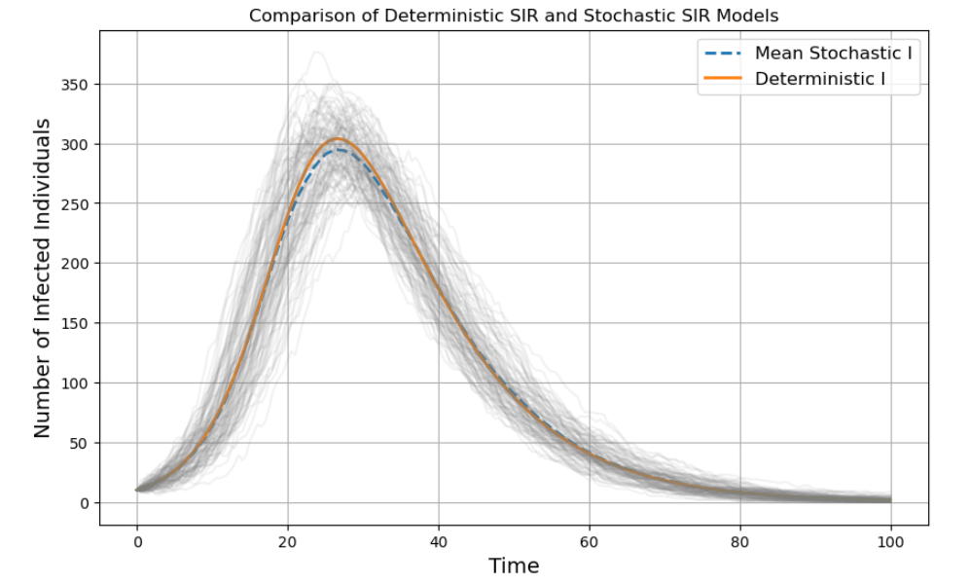
Stochastic SIR Vs Deterministic SIR Model
On the right we have a plot showing the difference between the stochastic and the deterministic SIR models’ I values under the same initial conditions. The grey lines indicate each of the 100 simulations of the stochastic SIR model that were run to obtain the mean plot.
By the grey lines we can see some extreme cases which will then be taken into account of for our mean stochastic line which we plotted which we find very closely approximates the deterministic plot.
This is because for a large population and a reasonably large initial infected group, the small-scale variations are largely negligible. However If we had a smaller population we may find that we have epidemics die out due to a series of repeated I -> R.
Despite the stochastic SIR model generally producing more realistic results, it also takes a lot more computational power to run so many simulations. Also we don’t obtain closed form solutions like you can easily find using the ODEs in the deterministic model.

Slide 12
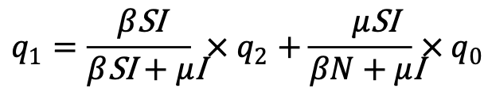


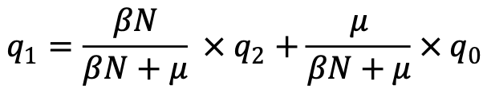
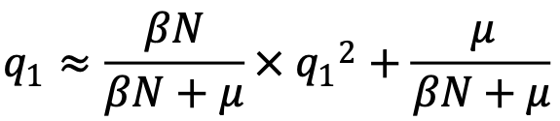
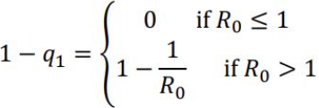

Derivation of analytic estimate of a major outbreak
Assume we start with one infected individual
Denote q_{i} = Prob(no major epidemic starting from i infected individuals)
Want to find 1–q₁ , the probability of a major outbreak
Two possibilities for the next event: infection or removal 𝑞₁ = P(infection) × 𝑞₂ + P(removal) × 𝑞₀
with I = 1 and S = N
as q₀ = 1 and q₂≈ q₁²
where
Taking the minimum non- negative solution

Slide 13
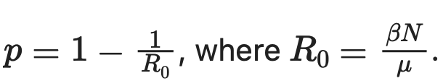
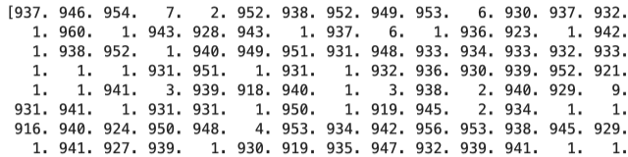
Finding probabilities of a major outbreak
For this section we used N = 1000, β = 0.0003, and μ = 0.1.
The probability of a major outbreak occurring can be estimated by running the deterministic model a large number of times (in our case 1000), and storing the final value of R in each case. Next, we count in how many simulations the final value of R exceeds 10, as it is very likely that if they exceed 10 a large outbreak would happen. This can be seen by printing all the final values of R, as they are (for the vast majority) either below 10 or in the 900’s.
Finally we take the number of simulation in which the final value of R exceeds 10, and dividing that by the number of simulations. This approximates the probability of a major outbreak.
Next we can compare this with the analytic estimate of a major outbreak given by
Using a large number of simulations gives estimates close to the analytic value. For example 1000 simulations gives a probability of around 0.671 (this changes every time the code is run due to the randomness of the stochastic model) where the analytic estimate gives 0.667.
Small sample of array of final R values, depicting that they are usually either below 10 or above 900 (a major outbreak).

Slide 14
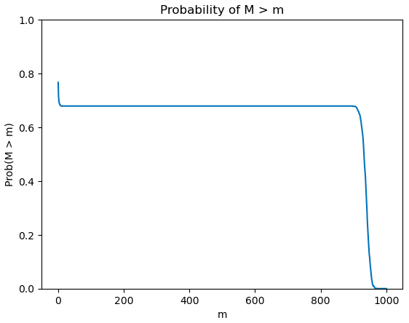
Finding probability of outbreak of any size
Taking this one step further, we can find the probability that the final value of R exceeds any value m between 1 and 1000.
This can be very useful for predicting the behaviour of the disease and choosing how to act accordingly.
From the graph on the right, we can see the probability that the final value of R exceeds 10 is almost the same as the probability of it exceeding 900, which agrees and justifies the use of 10 in the previous slide.
One thing to note is we are plotting the final value of R is strictly greater than m, which is why the probability does not approach 1 when m is small.
In the graph above M represents the final value of R

Slide 15
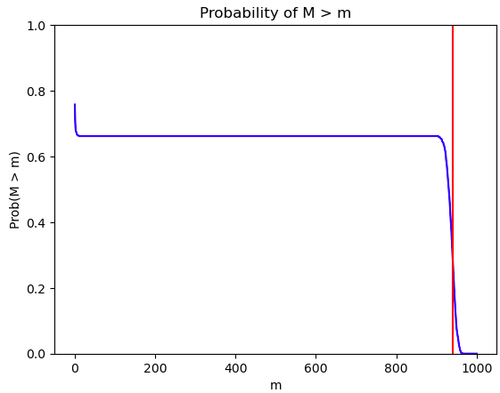

Finding probability of outbreak of any size
Recall the final size equation from earlier
Using N = 1000, β = 0.0003, and μ = 0.1 gives R(∞) = 940.5
From the graph we can see that the probability that
R(∞) > 940.5 is approximately 0.3

Slide 16
Definition of a severe outbreak
Possible ways to classify of a severe outbreak:
concurrent size (number of individuals infected simultaneously)
total infections
duration
Different definitions will be appropriate for risk assessment in different situations
Used to assess if an outbreak will exceed available resources, allowing to work out threshold capacity. E.g. for number of available beds use concurrent size or how much treatment to stockpile use total infections
Ebola outbreak in Congo in 2018:
53 cases
fast containment
not classified as severe outbreak

Slide 17
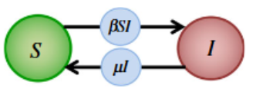
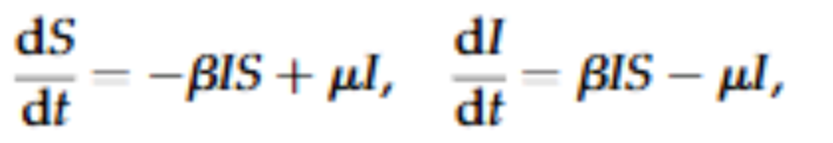
The SIS Model
Two compartments: susceptible and infected
β and μ control rates of movement between compartments
Assumptions:
individuals are infectious immediately after being infected
everyone mixes with everyone else
individuals can be infected infinitely many times
differential equations solved simultaneously

Slide 18
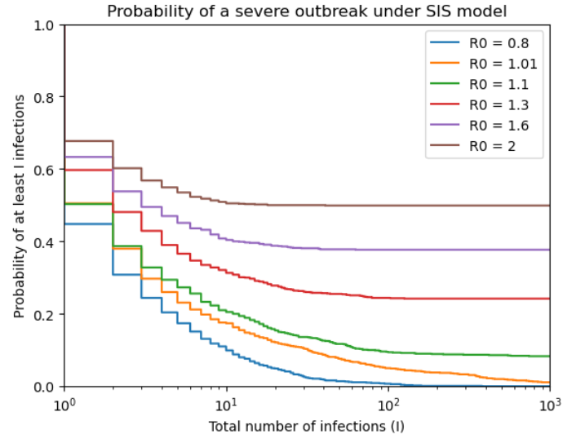
Probability of a severe outbreak
Severe outbreak defined by total number of infections
Stochastic SIS model with 1000 simulations
Step plot shows how probability decreases as total number of infections increases
SIS model can continue indefinitely if R0 >1
Simulations with a higher R0 have a higher chance of reaching a certain total number of infections
parameters: μ = 0.1, N = 1000, I(0) = 1

Slide 19
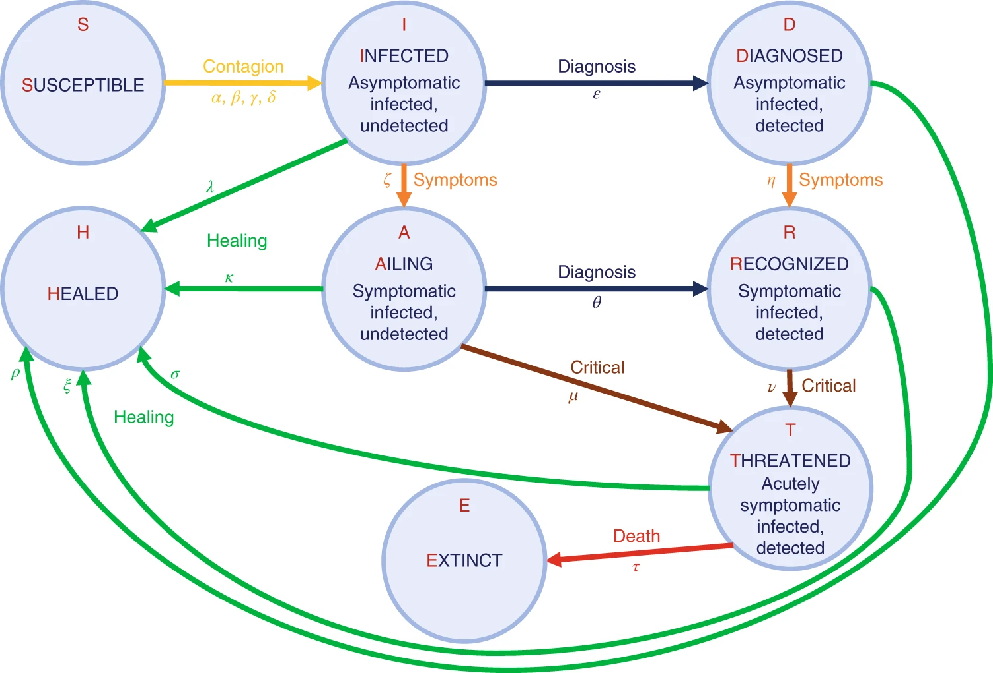
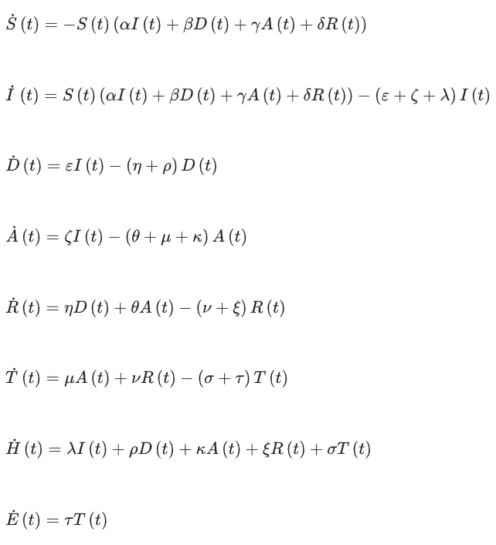
The SIDARTHE Model
This model is an extension of the classic deterministic SIR model, better designed to capture the complexities of the spread of diseases like COVID-19 and was used as a simple model during the early wave of infections in Italy, March 2020.
It takes into account stages of infection where the rate parameters may be different, for example when somebody is infected and diagnosed, due to the self-isolation rules, the chance for them to spread the disease by contact to another person would decrease dramatically and so the transmission rate should be lower for that group.
By other statistical analysis of the hospital cases we can find the parameters corresponding to the number of people who fall into a critical condition or pass away due to the disease which will then allow us to predict the pressure on health care systems. Which will allow us to better allocate resources.
This model was later extended to use fractional order differential equations which, rather than just depending on its current state, has a memory-effect where the disease evolution depends on past states too. Further reading into this can be found below. Higazy, M. (2020). Novel fractional order SIDARTHE mathematical model of COVID-19 pandemic. Chaos, Solitons & Fractals, 138, 110007. https://doi.org/10.1016/j.chaos.2020.110007
Fig. 1 and corresponding ODE equations.
Giordano, G., Blanchini, F., Bruno, R. et al. Modelling the COVID-19 epidemic and implementation of population-wide interventions in Italy. Nat Med 26, 855–860 (2020). Modelling the COVID-19 epidemic and implementation of population-wide interventions in Italy | Nature Medicine

Slide 20
Larger images

Slide 21
How we worked together
Once a week on Mondays, we met to discuss which sections we would all do and evenly distribute work. This was also a time where we could ask each other questions, or provide any feedback for each others code from previous parts.
Furthermore, we also had a shared workspace on GitHub, where we could upload and view the others code. This was useful as we could cooperate on tasks we were troubled with, or use code from someone else’s section if required, as many sections as linked.
Finally we had a WhatsApp group chat, which was very helpful for organising meetings, or asking questions regarding the code.

Slide 22
Thank you for listening!
Have you got any questions?

